Slide 1
Smoothing Splines and Local Regression
Bodie Sheehan, Erica Wiens, Sherly Yan, and Jonah Yesowitz Team 2-13

Slide 2
Recap
____________________ allow us to divide the data into a predetermined number of sections to fit separate, lower-degree polynomial across the data instead of a single, high-degree polynomial across the entire data set
____________________ makes these polynomials continuous at both its first and second derivatives in order to make the overall fit smooth
It is important for the overall fit to be both __________ and ______ for interpretability and to avoid overfitting the data
Notes:
Piecewise Polynomials Regression Splines
Continuous and smooth

Slide 3
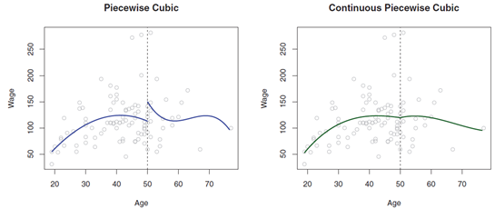
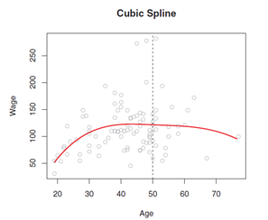
Recap

Slide 4
Regression Splines vs. Smoothing Splines
Regression Splines
Set number of knots
Need to determine number and location of knots
Smoothing Splines
Knots at every point
Need to determine value of lambda
Similarities
Aim to be smooth
Continuous at first and second derivatives

Slide 5
Smoothing Splines

Slide 6
Smoothing Splines -- Basic Idea
Centered around the idea that we want to find a function g(x) that fits the data well and minimizes RSS
However, only aiming to minimize RSS will lead to overfitting of the data
We would end up choosing g that interpolates all of the points
So, we want RSS to be small but the overall fit of the function g to be smooth

Slide 7
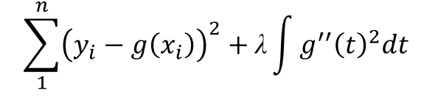
RSS
Tuning Parameter

Slide 8
Breaking Down the Smoothing Spline Expression
“Loss + Penalty” expression
We’ve seen this before with ridge regression and the lasso
Left side of the equation-- ”Loss” function
Makes g(x) want to fit the data as close as possible
Right side of the equation-- “Penalty” term
Depending on the value of lambda selected, penalizes the variability of g(x)
While we ultimately want to minimize the entire expression, different values of lambda will affect how closely the RSS function is allowed to fit the data
Remember: we don’t want to overfit the data!!

Slide 9
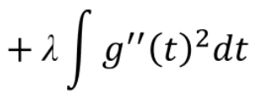
Lambda
Lambda determines how smooth the function will be
When lambda = 0, the penalty term will have no effect, and g will simply interpolate all the training observations
As lambda → ∞, g will be perfectly smooth, a straight line that passes as close as possible to the training points i.e. the least square line
Lambda effectively controls the bias-variance tradeoff for the function g

Slide 10
More About Lambda
Different from regression splines, we do not need to choose the number of knots nor where they are located
Instead, we must decide which lambda is best
As with many other models, cross-validation is the best tactic
Specifically, leave-one-out cross-validation

Slide 11
Quick Review on Derivatives
g’’(t) refers to the second derivative of g(t)
The first derivative g’(t) measures the slope of g(t)
The second derivative shows the rate at which the slope is changing, or, its roughness
∫ is simply a summation of the function within it
As a result, ∫ g”(t)² dt measures the total change in g(t) over its entire range
If g is jumpy, ∫ g”(t)² dt will be large and the first derivative will vary
If g is smooth, ∫ g”(t)² dt will be small and the first derivative will be relatively constant
Putting all of this together, we find that a large value of lambda will make g smoother by minimizing λ∫ g”(t)² dt
Notes:
Once the value of lambda is set:
if it is large, the minimization function must decrease the value of ∫ g”(t)² dt in order to make up for the larger lambda, and thus will be smoother
If it is small, the lambda will have a lesser effect on the overall equation, and the RSS expression will play a larger role (there will be little to no penalty), so the model will be rougher

Slide 12
Special Properties
g(x) is a shrunken natural cubic spline with knots at each point where lambda determines the level of shrinkage
This is different from regression splines where we needed to determine how many knots to use and where to place them
g(x) is also continuous at both its first and second derivatives
This ensures the spline is continuous at each knot
Just like natural splines, g(x) is linear in the region outside the extreme knots (outside the first and last points)

Slide 13
Note on Degrees of Freedom
As we saw with cubic splines, degrees of freedom are relative to the number of knots, so it would seem that smoothing splines have far too many
But, lambda controls the roughness of the smoothing spline, so it affects the effective degrees of freedom
It is possible to show that as λ increases from 0 to ∞, the effective degrees of freedom, which we write df(λ), decrease from n to 2

Slide 14
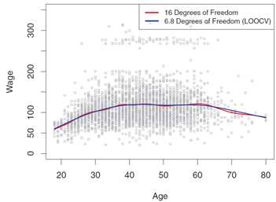
Example
Red curve -- 16 degrees of freedom (pre-specified directly)
Blue curve -- 6.8 degrees of freedom (determined by LOOCV)
The curve with 6.8 degrees of freedom is preferred because it is much less complex and achieves a very similar result

Slide 15
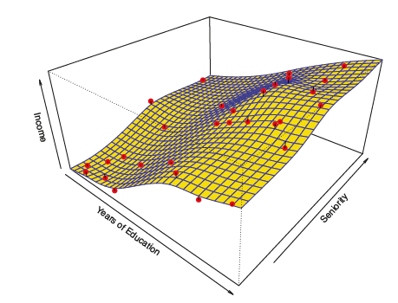

Extension: Thin Plate Spline
Analogy comes from bending a thin sheet of metal
Just as the metal resists bending, the thin plate spline uses a similar penalty term to resist the smoothness of the fit
Can be represented as a three dimensional spline
Uses: Low dimensional regression
Notes:
Since it is in 3 dimensions, we can use the thin plate spline to predict a variable (income) with two different predictors (years of education and seniority)
Should have x1 and x2 in the sum of the equation

Slide 16

And Now for Code!

Slide 17
Local Regression

Slide 18
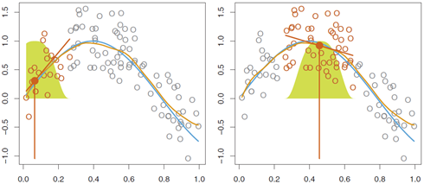
Local Regression
Local regression involves computing the fit at a target point x₀
It uses only the nearby (local) training observations.
The blue curve represents f(x) from which the data were generated
The light orange curve is the local regression estimate f-hat(x).
The dark orange colored points are “local” to the target point x₀, represented by the orange vertical line.
The yellow bell-shape superimposed on the plot indicates weights assigned to each point, decreasing with distance from the target.

Slide 19

Local Regression
The f-hat(x) at x₀ is obtained by using these weights to fit a weighted linear regression (orange line segment), and using the fitted value at x₀ (orange solid dot) as the estimate f-hat(x₀).
Local regression is sometimes called a memory-based procedure because we need all the training data each time we want to make a prediction.
In order to obtain the f-hat(x) at a new point, we need to fit a new weighted least squares regression model by minimizing: once again for a new set of weights.

Slide 20
Local Regression Algorithm Steps
Gather the fraction s = q/n of training points, whose x_{i} is closest to x₀.
s:
q:
n:
Assign weights to each point in the neighborhood
Weight determined by the function K_{i0} = K(x_{i}, x₀)
Point closest to x₀ has highest weight.
All but the k nearest neighbors get weight zero.

Slide 21

Next Step: How Do We Compute the K_{i0}
Suppose q denotes the number of points in the local neighborhood of x₀ and d₁, d₂ … d_{q} denote the distances in increasing order of the q points closest to x₀ (i.e.: farthest to closest)
The point at distance d_{i} from x₀ is given a weight K_{io} in the local regression that decreases as the distance from x₀ increases.
The loess() function uses a tricube weight function to define 𝐾_{io} as follows:

Slide 22


Local Regression Algorithm Steps
3. Fit a weighted least squares regression of the y_{i} on the x_{i} using the aforementioned weights, by finding 𝛽-hat₀ and the 𝛽-hat₁ that minimize: *K_{io} will differ for Each value of X_{o} 4. Find the f-hat(x) at x₀ by using the equation

Slide 23
The Choices We Make
The most important choice is the value of span s, defined in Step 1.
The span plays a role like that of the tuning parameter λ in smoothing splines: it controls the flexibility of the non-linear fit.
The smaller the value of s, the more local and flexible the fit
A very large value of s will lead to a global fit to the data using all of the training observations.
We can again use cross-validation to choose s, or we can specify it directly.

Slide 24
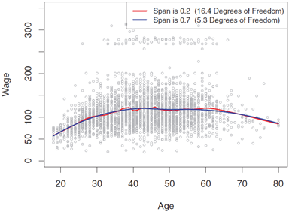
Local Regression
The figure above displays local linear regression fits on the Wage data, using two values of s: 0.7 and 0.2.
Recall that the span specifies the fraction of the data used to compute the fit at each target point.
As expected, the fit obtained using s = 0.7 is smoother than that obtained using s = 0.2.

Slide 25
Generalization
The idea of local regression can be generalized in many different ways
In a setting with multiple features X₁,X₂, ..., X_{p}, one very useful generalization involves fitting a multiple linear regression model that is global in some variables, but local in another, such as time.
Such varying coefficient models are a useful way of adapting a model to the most recently gathered data.

Slide 26
Loess versus Lowess
The R function loess is newer, and has four things which lowess doesn't:
It accepts a formula specifying the model rather than the x and y matrices
It can be used with more than one predictor.
It accepts prior weights.
It will estimate the "equivalent number of parameters" implied by the fitted curve.
On the other hand, loess is much slower and occasionally fails when lowess succeeds, so both programs are kept in R.
When there is only one predictor variable and no prior weights, loess and lowess are in principle exactly equivalent.

Slide 27
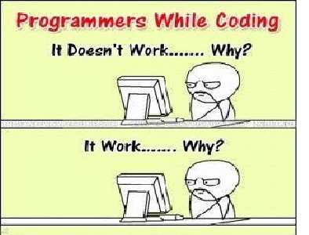
And now for Code

Slide 28
Thank you!
Notes:
Jonah

